Slide 1
Data Structure of Triangle Meshes
Yutaka Ohtake
Department of Precision Engineering
The University of Tokyo

Slide 2
Contents
Adjacent vertex lists
Example of usage : computing Laplacians
Adjacent face lists
Example of usage : computing vertex normals
Face mates
Example of usage : linear subdivision

Slide 3
Adjacent Vertex Lists (vertex-to-vertices)
At each vertex, we store the neighboring vertices.
List 0 : {1,5,6,7}
List 1 : {5,2,0}
…
(Please complete here)
1
2
0
5
6
3
7
4
8

Slide 4
Data Structure
Two dimensional array with varying their lengths.
int *listSizes;
int **adLists;
void printAdjacentList(int i){
int size = listSizes[i];
int* list = adLists[i];
for(int j=0; j<size; j++){
printf(“%d-th vertex is adjacent to %d-th vertex\n”,
list[j], i);
}
}

Slide 5
Algorithm of List Construction
For each triangle (A, B, C)
Append A to B's list
Append B to C's list
Append C to A's list
Actually, the above can not compute the correct lists in some cases. Please indicate such cases.

Slide 6
Implementation (For the people who do not like std::vector)
1. Count the size of lists for memory allocation.
listSizes = new int[numVertices];
for(int i=0; i<numVertices; i++)
listSizes[i] = 0;
for(int i=0; i<numTriangles; i++)
for(int j=0; j<3; j++)
listSizes[triangles[i][j]]++;
adLists = new int*[numVertices];
for(int i=0; i<numVertices; i++){
adLists[i] = new int[listSizes[i]];
listSizes[i] = 0;
}
2. Construct the list.
for(int i=0; i<numTriangles; i++){
int* t = triangles[i];
for(int j=0; j<3; j++)
adLists[t[j]][listSizes[t[j]]++] = t[(j+1)%3];
}

Slide 7
Computing Laplacians (Re-visited)
Using adjacent vertex lists, you can compute Laplacian at a vertex without traversing all triangles.
Please re-implement Laplacian smoothing by using adjacent lists

Slide 8
Contents
Adjacent vertex lists
Example of usage : computing Laplacians
Adjacent face lists
Example of usage : computing vertex normals
Face mates
Example of usage : linear subdivision

Slide 9
Adjacent Face Lists (vertex-to-faces)
At each vertex, we store the neighboring triangles.
List 0 : {0,4,5}
List 1 : {1,0}
…
(Please complete here)
1
2
1
0
0
5
4
2
3
5
6
3
7
6
8
7
4
8

Slide 10
Data Structure
Same as vertex-to-vertices list.
int *listSizes;
int **adLists;
void printAdjacentList(int i){
int size = listSizes[i];
int* list = adLists[i];
for(int j=0; j<size; j++){
printf(“%d-th triangle is adjacent to %d-th vertex\n”,
list[j], i);
}
}

Slide 11
Algorithm of List Construction
For each triangle (A, B, C)
Append the triangle ID to B's list
Append the triangle ID to C's list
Append the triangle ID to A's list
Please implement the above. Then re-implement vertex normal computation by using the list for vertex-to-triangles.

Slide 12
Contents
Adjacent vertex lists
Example of usage : computing Laplacians
Adjacent face lists
Example of usage : computing vertex normals
Face mates
Example of usage : linear subdivision

Slide 13
Face mates (face-to-faces)
At each triangle, we store the three triangles sharing the edges.
9
0-th triangle (0,3,1): [4,9,1]
1-st triangle (0,4,3): [2,0,-1]
…
(Please complete here)
0
9
4
1
0
1
3
4
2
3
5
2
5
8
6
8
7
6
7
No mate

Slide 14
Algorithm of Mate Construction
Construct the adjacent face lists.
For the i-th triangle (A,B,C)
Set mate for A to the triangle (not i-th) containing B in the C's list
Set mate for B to the triangle (not i-th) containing C in the A's list
Set mate for C to the triangle (not i-th) containing A in the B's list
C
i
Mate for A
A
B

Slide 15
Implementation
int (*mates)[3];
void constructFaceMates(){
constructAdjacentFaceLists();
mates = new int[numTriangles][3];
for(int i=0; i<numTriagles; i++){
for(int j=0; j<3; j++){
mate[i][j] = -1;
int v = triangles[i][(j+1)%3];
int size = listSizes[triangles[i][(j+2)%3]];
int* list = adLists[triangles[i][(j+2)%3]];
for(int k=0; k<size; k++){
if(list[k] == i) continue;
int *tk = triangles[list[k]];
if(tk[0] == v || tk[1] == v || tk[2] == v){
mate[i][j] = list[k]; break;
}
}
}
}
}
Vertex ID to be searched

Slide 16
Edges
Let’s consider only 2-manifold meshes
Edges are shared by one or two triangles
Inner edge (shared by two triangles)
Boundary edge (shared by one triangles)
Non-manifold edge (shared by more than tree triangles)
We can identify them using mate data.

Slide 17
Counting Edges
Please complete the function for counting edges.
int numEdges;
void countEdges(){
constructFaceMates();
numEdges = 0;
//Increment #edges by traversing mates
for(int i=0; i<numTriangles; i++){
//???
}
}

Slide 18
Assigning Edge IDs to Triangles
From each triangle, we store the three edge IDs.
Numbering edges are not unique.
0
8
0-th triangle (5,4,2): [5,4,1]
1-st triangle (6,5,2): [4,10,7]
…
(Please complete here)
1
6
2
3
3
2
9
11
3
5
4
5
7
0
6
1
4
1
0
10
4
5
2

Slide 19
Assigning Edge IDs
Please complete the function for assigning edge IDs.
int (*edgeIDs)[3];
int numEdges;
void assignEdgeIDs(){
constructFaceMates();
numEdges = 0;
edgeIDs = new int[numTriangles][3];
for(int i=0; i<numTriangles; i++){
//???
}
}
HINT : you can do it together with counting #edges.

Slide 20
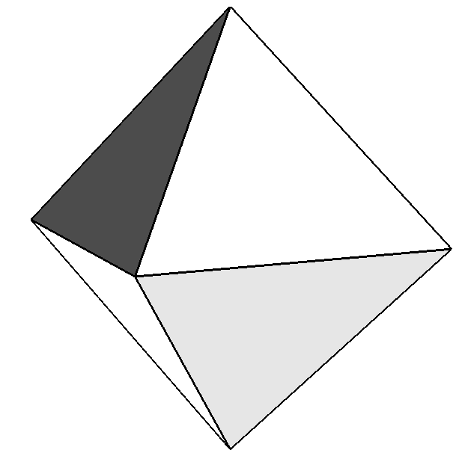
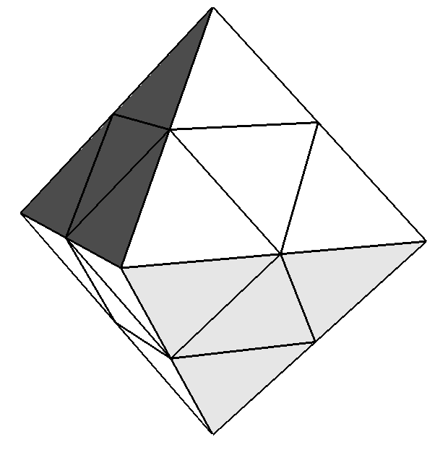
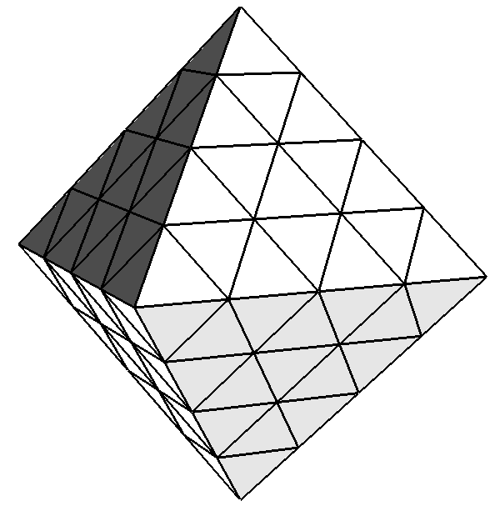
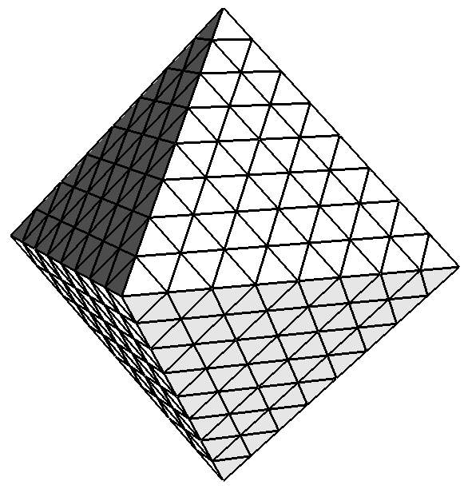
Mesh Subdivision
Triangles are subdivided using a certain rule.
1-to-4 linear subdivision

Slide 21
#vertices and #triangles after 1-to-4 subdivision
#(new triangles) = 4 times #(old triangles)
#(new vertices) = #(old vertices) + #(old edges)
Old mesh
New mesh

Slide 22
Vertex IDs of New Mesh
ID of a new vertex on an old edge = ID of the old edge + #(old vertices)
Denoted by V
A
Subdivided four triangles
(A, D+V, E+V)
…
(Please complete here)
D
E
B
F
C

Slide 23
Algorithm of 1-to-4 Linear Subdivision
Compute edge IDs with counting #edges
Allocate memory for the new vertices and triangles
Compute the new vertex positions
Create the new triangles
Update the mesh data

Slide 24
Implementation
//Step 1.
assignEdgeIDs();
//Step 2.
float (*newVerteces)[3] = new float[numVertices + numEdges];
int (*newTriangles)[3] = new int[4*numTriangles];
//Step 3. (Complete here)
//Step 4. (Complete here)
//Step 5.
delete[] vertices;
delete[] triangles;
vertices = newVertices;
triangles = newTriangles;
numVertices += numEdges;
numTriangles *= 4;

