Slide 1
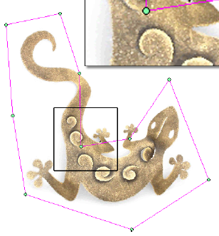
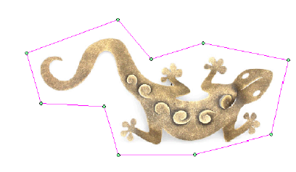
Green Coordinates
Y. Lipman D. Levin D. Cohen-Or
What for ?
Deforming 2D/3D objects.
boundary + inside
Deform
2D image

Slide 2
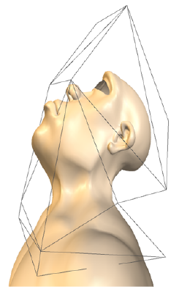
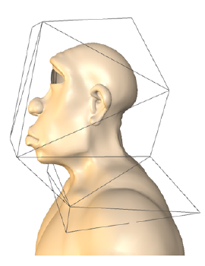
How to Deform?
Cage based space warping
A deformed point is represented as a relative position with the cage.
Cage 2D : polygon
3D : polyhedron
Coordinates
3D mesh

Slide 3
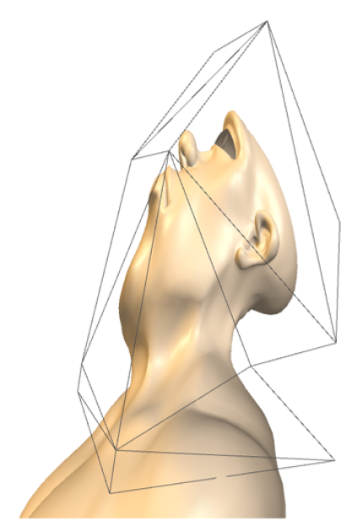
Conventional Coordinates
Linear combination of cage vertices
Coordinates :

Slide 4
An Example (Barycentric coordinates on simplex)
Triangulated cage

Slide 5
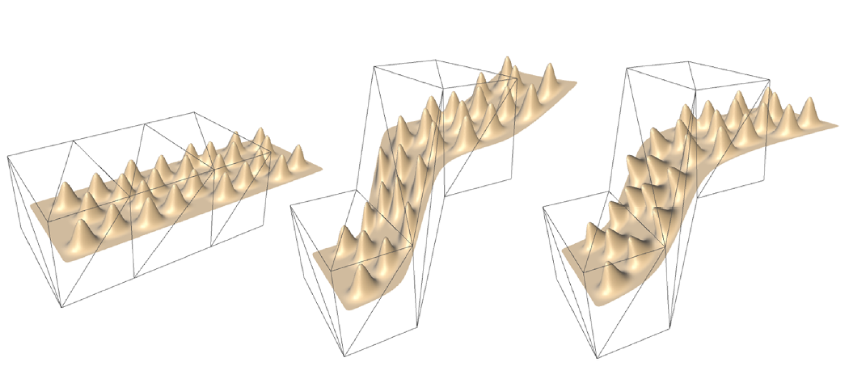
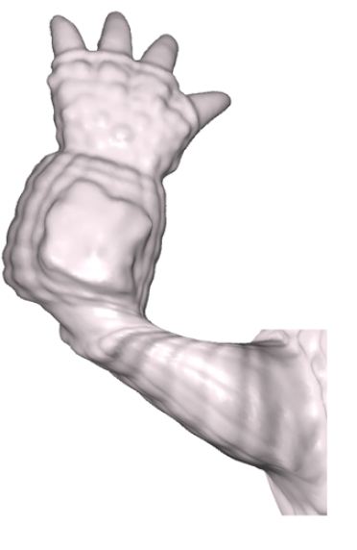
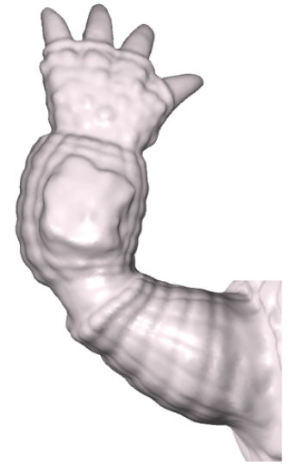
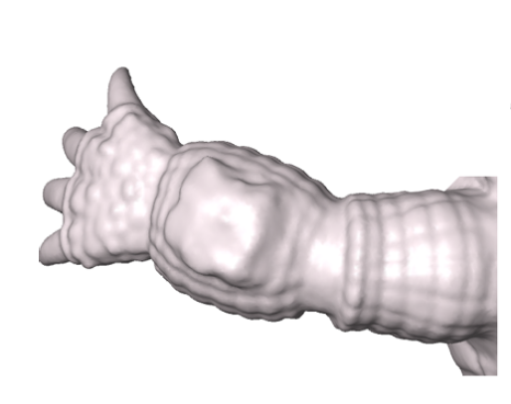
Problems of Conventional Methods
Shape-preservation is difficult
Each of (x,y,z) is deformed individually.
Conventional
Proposed

Slide 6
Previous Work for Deformation
Surface based.
+ Shape-preservation
- Must solve (non-)linear equations.
Space warping based.
+ Computationally efficient
- Difficult to preserve shape
Contribution of this paper: Shape-preserving deformation using Space warping.

Slide 7
Proposed Method
Coordinates using normals
Coordinates :

Slide 8
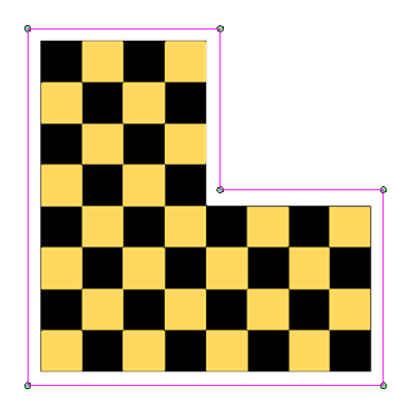
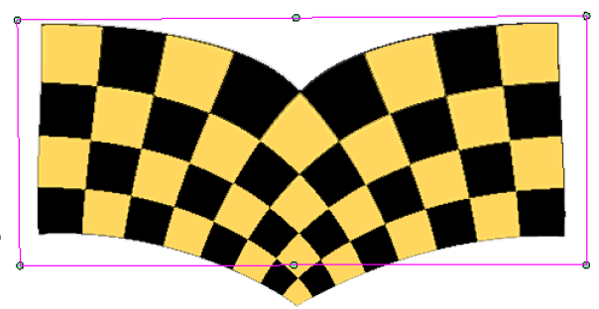
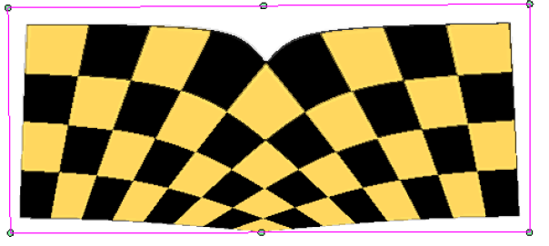
Interpolation vs. Approximation
It is not possible to achieve to conformal mapping using interpolation methods.
Interpolation (not conformal)
Approximation (conformal)
All coordinates are possibly non-zero.
Coordinates :
Sometimes negative.

Slide 9
Harmonic Function
As flat as possible
If the boundary condition is linear, then the linearity is reproduced.
Necessary condition of a conformal mapping
Solve PDE :
Boundary
conditions
1D case

Slide 10
Solution using Green’s Identity (In textbook part)
(Impulse function)
Green’s function of Laplacian :
Next page

Slide 11
Solution using Green’s Identity
Polygonize the boundary
Barycentric coordinates

Slide 12
Calculation of Green Coordinates
cage

Slide 13
Properties of Green Coordinates
Linear reproduction →
Translation invariance →
Rotation and scale invariance → We need an appropriate scaling of normals. (Next page)
Shape preservation → 2D : Conformal (Proved in the other paper) → 3D : Quasi-conformal (Seems to be checked experimentally. Max. distortion = 6)
Smoothness → {φ} and {ψ} are smooth and harmonic

Slide 14
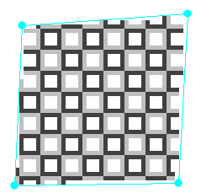
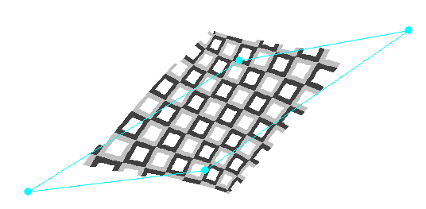
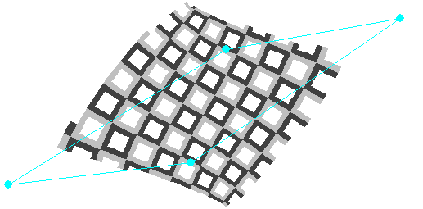
Scaling of Normals
Conformal

Slide 15
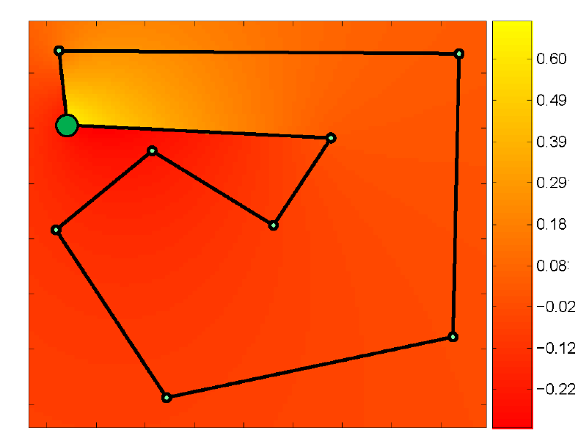
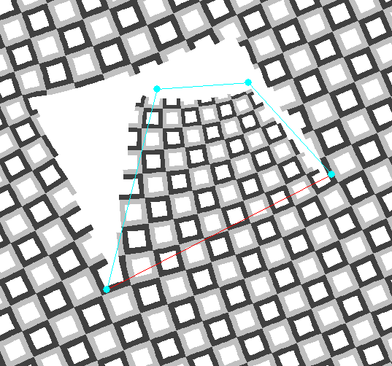
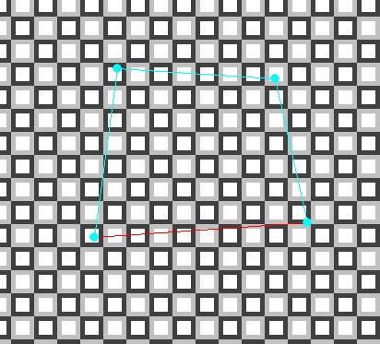
Extension to Cage’s Exterior
Interior:
Exterior:
→ Try to extend the coordinates through a specified face (exit face).

Slide 16
How to Extend ?
Should keep also in exterior :
Two equations in 2D case
Make unknown,
then decide them
by solving a linear system
cage

Slide 17
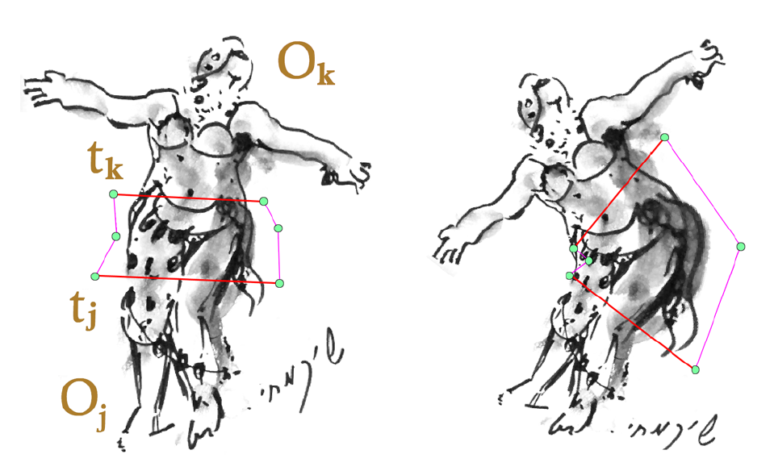
Multiple Exit Faces
Separate the space.
Separation
curve
Conforming in the cage

Slide 18
Discussions
Only for deformation ?
FEM basis ?
Interpolating a target shape ? (non-linear system must be solved)
Conforming two adjacent cages ?
→ Maybe NO.

