Slide 1

Smoothing of Partition of Unity
Implicit Surfaces for Noise Robust Surface Reconstruction
Yukie Nagai Yutaka Ohtake Hiromasa Suzuki
Notes:
Thank you for your introduction.
Today I will talk about Smoothing of Partition of Unity
Implicit Surfaces
for Noise Robust Surface Reconstruction.
This is worked in cooperation with Yutaka and Hiromasa.

Slide 2
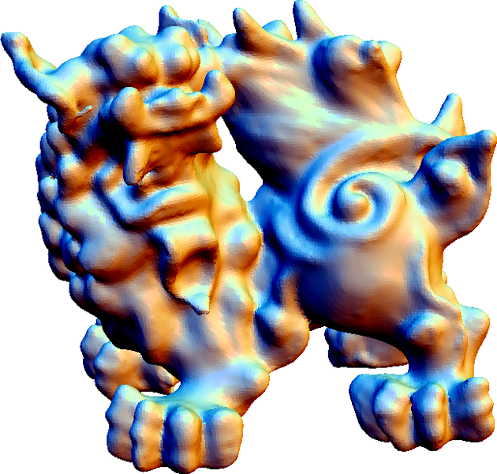
Outline
Introduction
Algorithm
Results
Conclusion & Discussion
Notes:
This is the outline of our presentation.
First, I will introduce our research.

Slide 3
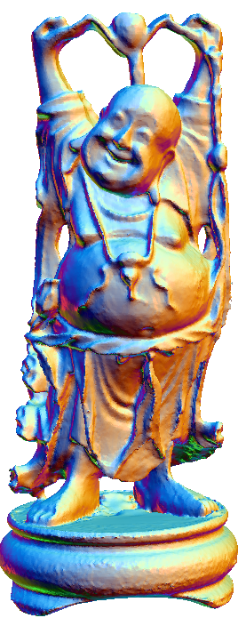
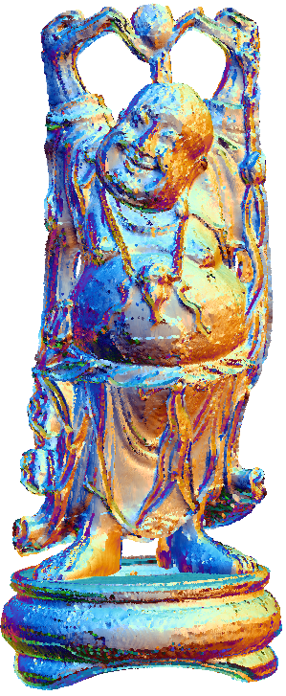
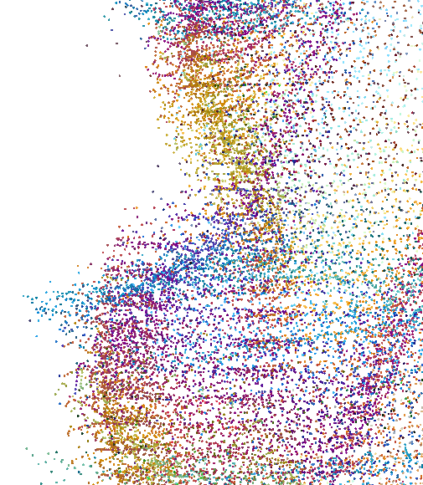
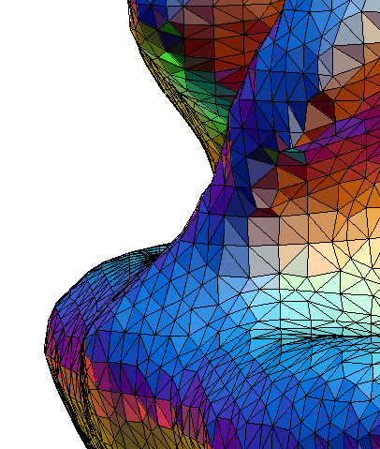
Surface Reconstruction
Point cloud
Surface mesh
Explicit
Implicit
  Global
  Local
Notes:
Our aim is surface reconstruction
from points sampled from the surface of an object.
//Point cloud can be obtained by several scanning method.
Surface mesh plays very important roles in many areas
Such as CG, CAD, CAE, and so on.
Many algorithms have been proposed and
they are classified based on their algorithms.
explicit and implicit, global and local.
**************************
View direction: 0, 60, 30

Slide 4
Previous Works
Explicit
  Delaunay based method
    Power Crust [Amenta et al. 01], Robust Cocone [Dey and Goswami 06], Eigencrust [Kolluri et al. 04], …
Implicit
  Global
    RBF [Carr et al. 01], Graph-cut [Hornung and Kobbelt 06], Voronoi+variational [Alliez et al. 07], FEM [Sharf et al. 07], Poisson surface reconstruction [Kazhdan et al. 06], …
  Local
    VRIP [Curless and Levoy 96], MLS [Alexa et al. 01], MPU [Ohtake et al. 03], …
Notes:
A typical explicit method is
Delaunay based one.
It involves Power Crust,
Robust Cocone,
Eigencrust.
implicit methods have an advantage to handle a low quality data
such as data with noise, outliers and lack of sampling.
Global implicit methods include
RBF, Graph-cut based algorithm,
the integration of Voronoi diagrams and the variational method ,
FEM approach,
Poisson surface reconstruction.
Local Implicit algorithm involves
VRIP, moving least squares, multi-level partition of unity implicits.

Slide 5
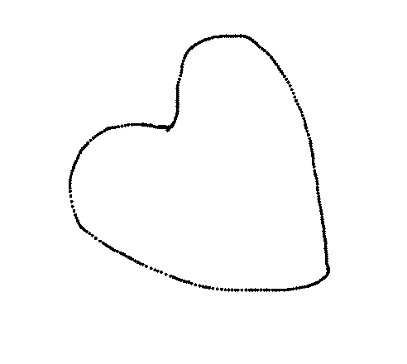
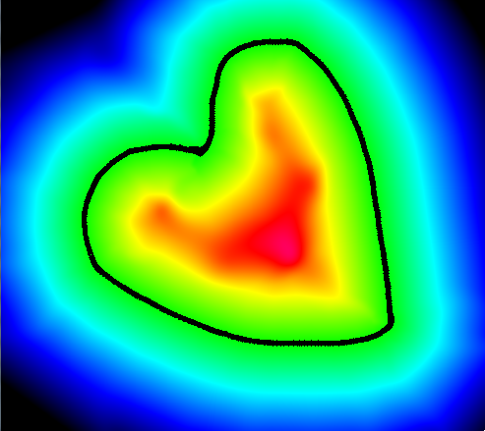
Local Implicit Methods
Highly accurate
Noise robust
Low computational cost
Our method is based on Partition of Unity (PU) [Ohtake et al. 03]
…Previous algorithms are based on
only local fitting
Notes:
We focus on Local Implicit Methods.
It has advantages in high accurate representation,
noise robustness, and low computational cost.
Our algorithm is based on Partition of unity approach proposed by Ohtake et al.
Hereafter we abbreviate partition of unity as PU.
It generates an approximation function by a point cloud.
Here is a 2D example.
From the sampling points in the left figure,
An approximation function is generated.
The right figure is a scalar field if the approximation function.
Black line means the reconstructed surface.
We can say that
The previous algorithms in this category are
based on only local fitting.

Slide 6
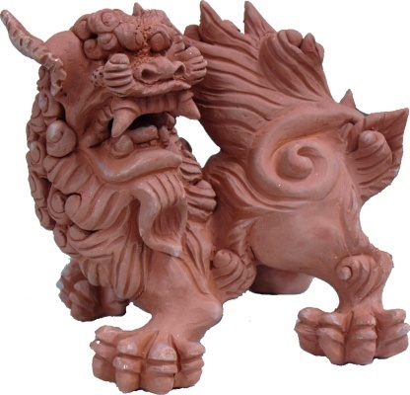
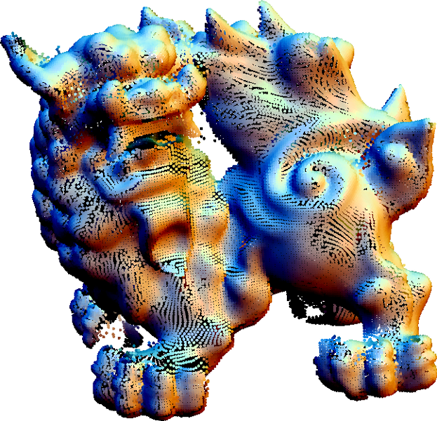
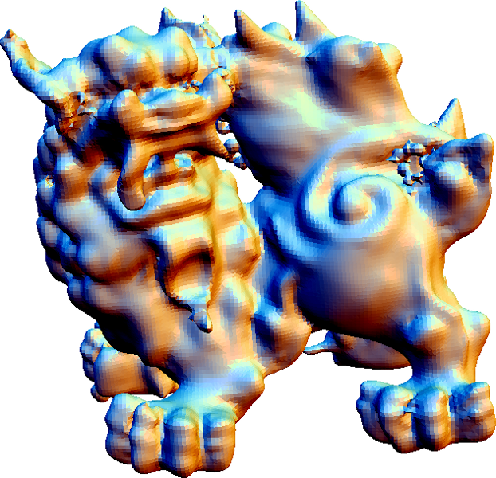
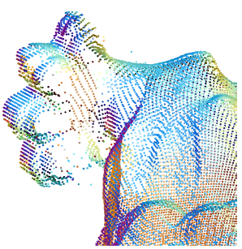
Problems of Local Fitting
Lack of sampling
Large amount of noise
Object
Outliers
Large differences
in sampling density
Points
Reconstructed model
Notes:
Local fitting is sensitive to lack of sampling, ,…
.
The result model may have extracomponents and
largely deformed shape.

Slide 7
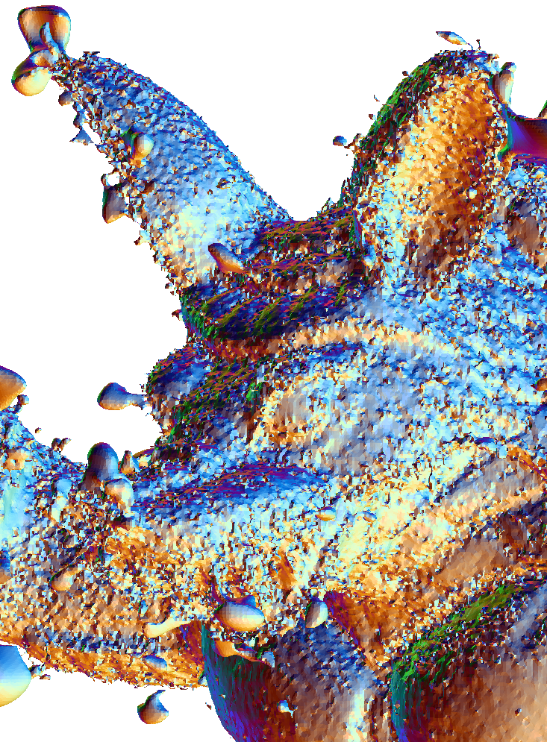
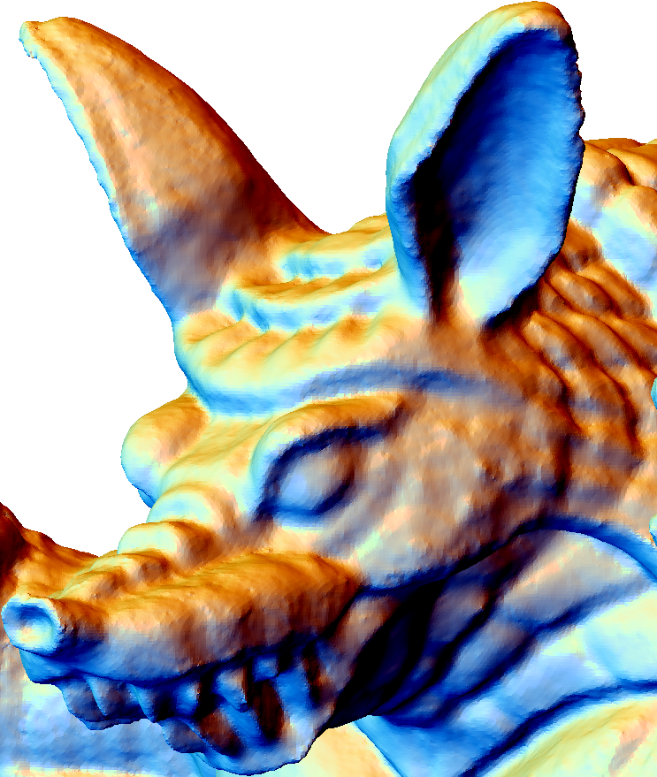
Our Approach
Local fitting + Smoothing
Local fitting
+ Smoothing
Local fitting
Notes:
We fix this problem by combining
Local fitting and Smoothing.
The left image is a result only by local fitting.
By smoothing, we obtained the model in the right figure
This combination enables precise and robust surface reconstruction.

Slide 8
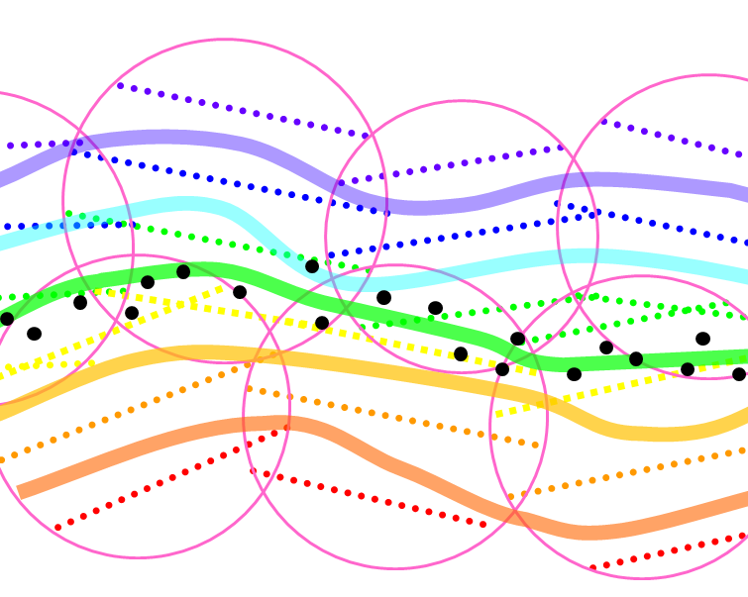
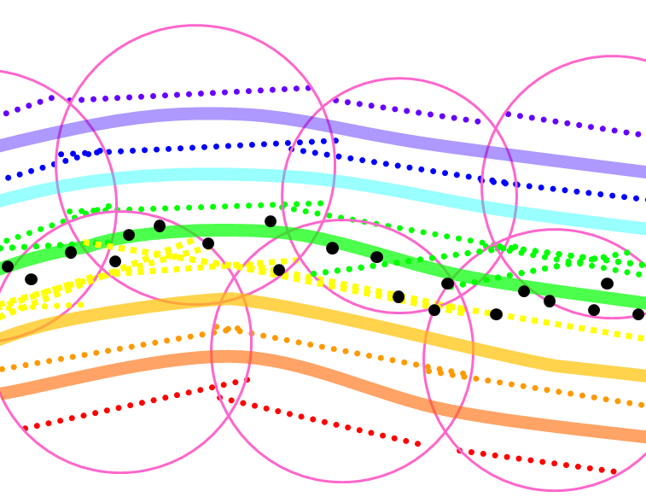


Differential Operators for Smoothing
Laplacian and Divergence operators for spherical cover
  Similar to tetrahedral mesh version [Tong et al. 03]
Notes:
We smooth local approximation functions
with Laplacian and Divergence operators for a spherical cover .
We derived these operators
similarly to the tetrahedral mesh version by Tong.

Slide 9
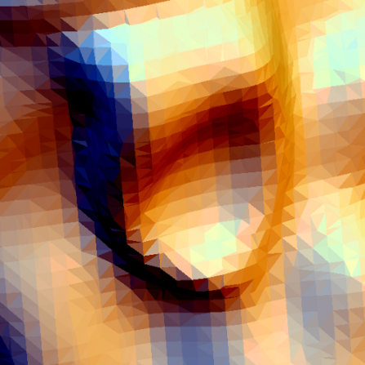
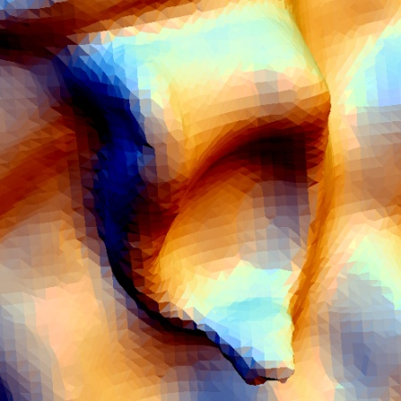
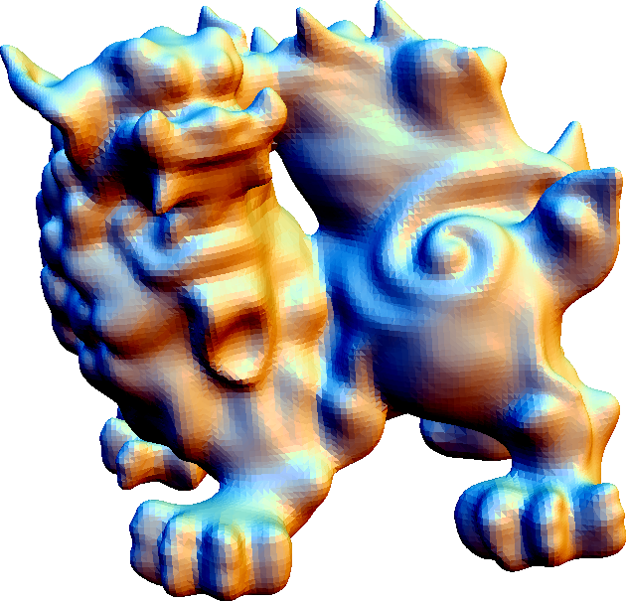
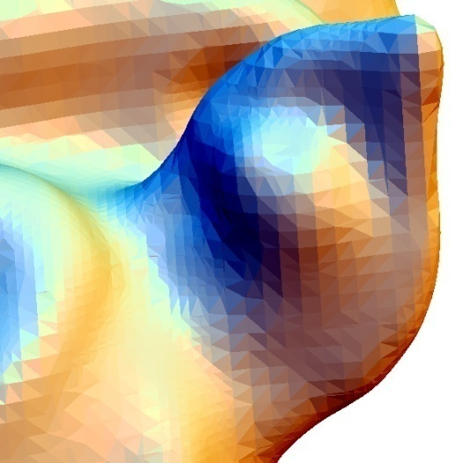
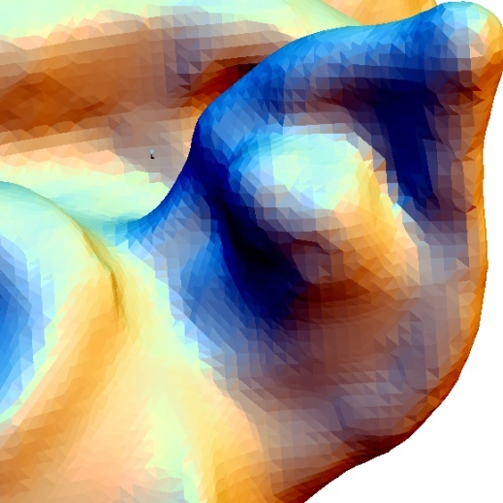
Comparison with Previous Works
Poisson surface
reconstruction [Kazhdan et al. 06]
Our approach
Notes:
Here is an example of the result.
We compared our result with Poisson surface reconstruction by Kazhdan.
Highly curved regions are shrunk in the result by Poisson surface reconstruction.
But our approach gives more precise result.

Slide 10
Outline
Introduction
Algorithm
Results
Conclusion & Discussion
Notes:
Next, I will explain the algorithm details.

Slide 11
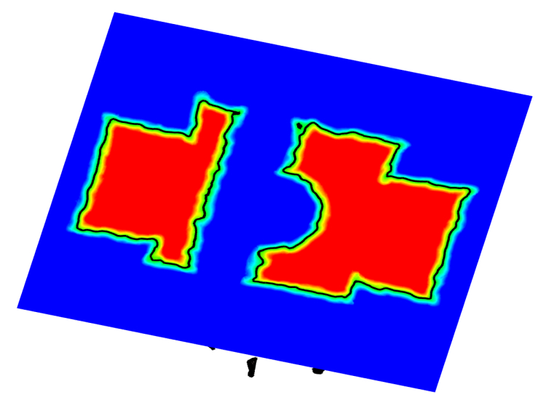
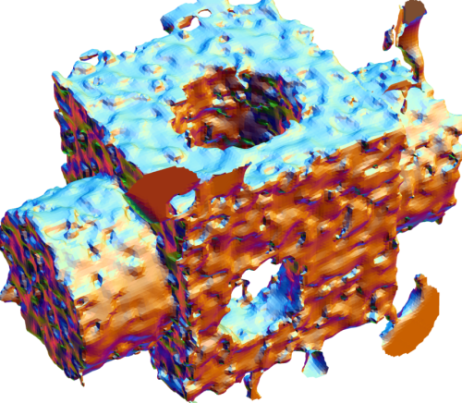
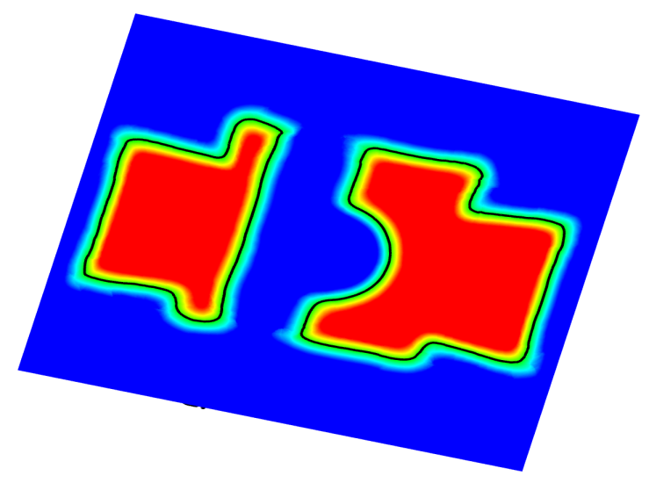
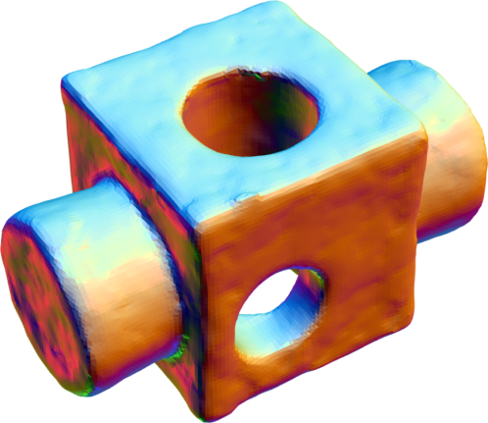
Overview
PU generation
Generate initial spherical cover
Smoothing
Iterative smoothing for local functions
Mesh generation
Implicit surface polygonization
SurfaceNets [Gibson 98]
Notes:
This is an overview of the algorithm.
First we generate an initial spherical cover and obtain a PU.
Then, local functions are iteratively smoothed using Lap. operator.
Finally the 0-level set is polygonized.
based on the SurfaceNets by Gibson.

Slide 12
Overview
PU generation
Generate initial spherical cover
Smoothing
Iterative smoothing for local functions
Mesh generation
Implicit surface polygonization
SurfaceNets [Gibson 98]
Notes:
The first step is PU generation.

Slide 13
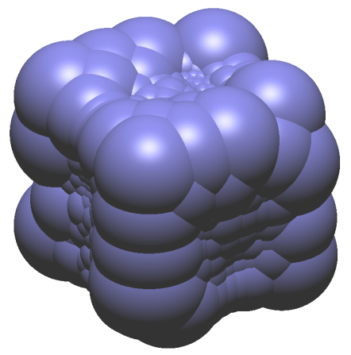
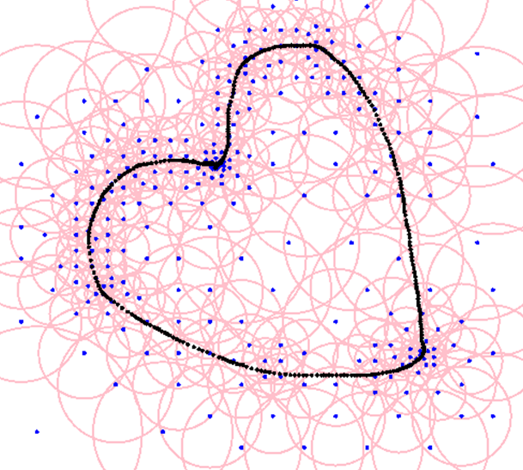
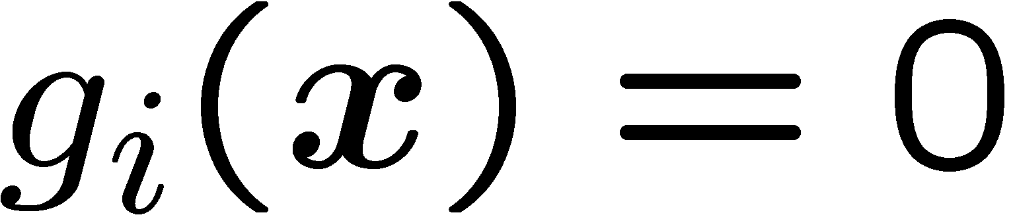

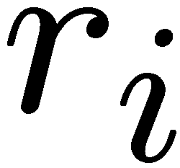
Partition of Unity
3D spherical
cover
Covering a space with spheres
Each sphere is associated with a function
Least square fitting
Points with normals
Notes:
PU is a shape representation covering a space with spheres.
Each sphere is associated with a function g_i(x).
In this work, g_i is a linear function represented in this inner product form.
Here is an example of a 2D spherical cover.
Sampling points are indicated with black poitns.
The isosurface g_i=0 approximates the surface inside the support.
Such g_i can be obtained by the least square fitting.
And here is an example of a 3D spherical cover.

Slide 14
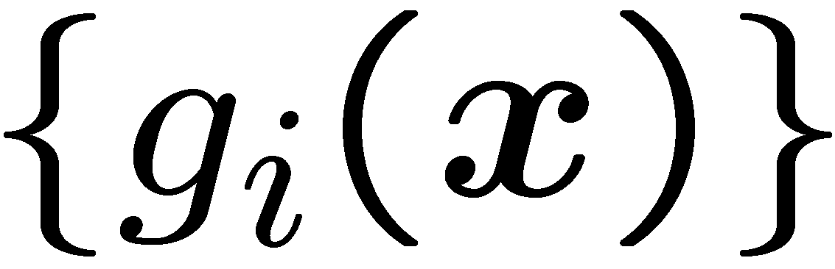
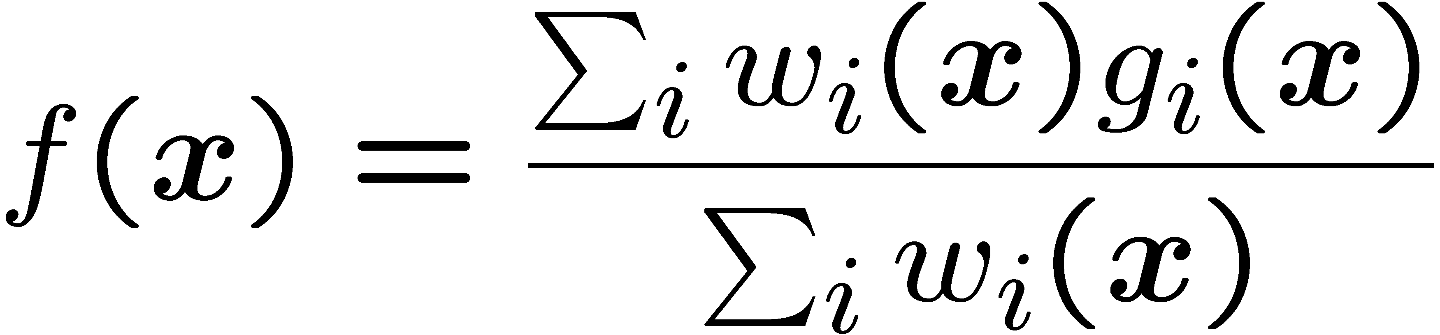
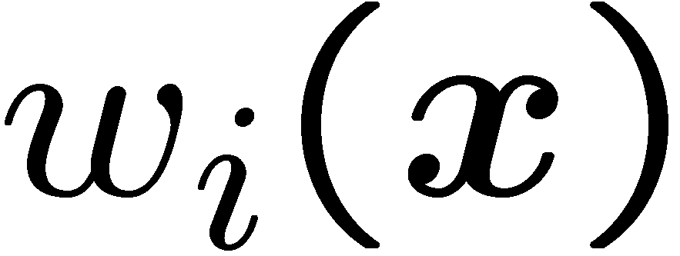

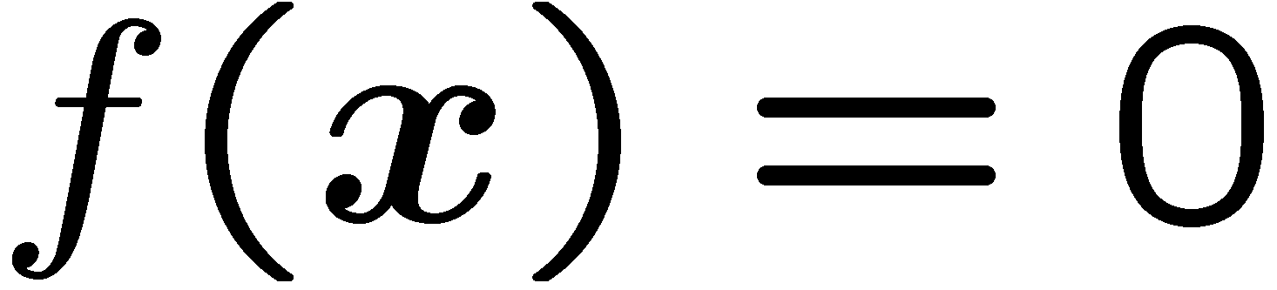
Partition of Unity
Weighted average of
Signed distance from the surface
Surface～
Notes:
After a spherical cover is generated,
An weighted average of g_i s is obtained.
The weighted average f(x) can be represented like this.
The weighting function W_i ) is the 2-nd degree B-Spline in this work.
The function f(x) approximates the signed distance from the surface
So the isosurface f(s)=0 represents the surface.

Slide 15
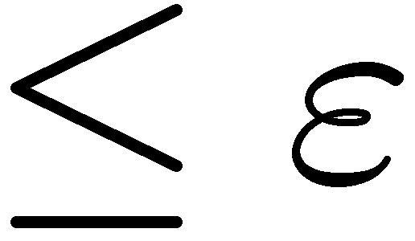
Spherical Covering
Octree-based ex. MPU [Ohtake et al. 03]
One support for one octant
Support expansion and elimination
Select randomly
Expand support
App. error
Eliminate
included supports
Notes:
We generate a spherical cover based on an octree as MPU method.
In the initial spherical cover, each octant has a support.
Then we randomly select a support and expand it
while the approx. error of g_i does not exceed an error tolerance epsilon.
Included supports are eliminated.
We iterate this support expansion and elimination.

Slide 16
Overview
PU generation
Generate initial spherical cover
Smoothing
Iterative smoothing for local functions
Mesh generation
Implicit surface polygonization
SurfaceNets [Gibson 98]
Notes:
The next step is smoothing.

Slide 17
Algorithm: smoothing PU
Iterative smoothing
Evaluation
of the gradient field
PU generation
Smoothing
Laplacian smoothing
of the gradient field
Mesh
generation
Integrate
the smoothed
gradient field
(solve Poisson equation)
Notes:
This is an overview of the smoothing.
It is an iterative algorithm.
First we evaluate the gradient field.
Then smooth the grad. field by Lap. Smoothing.
Finally integrate the smoothed grad. field.
by solving a Poisson equation.
In the 2nd and the last step, we need Laplacian and Divergence operators.

Slide 18

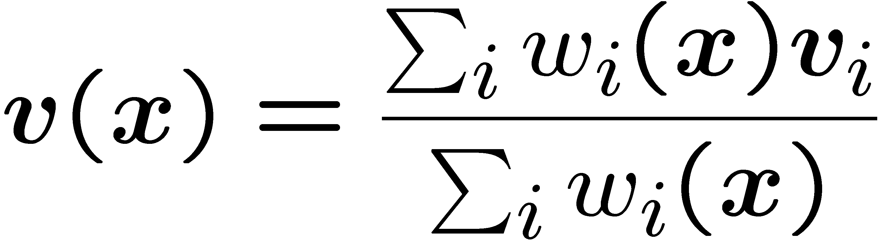
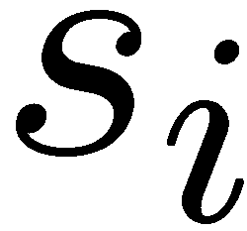
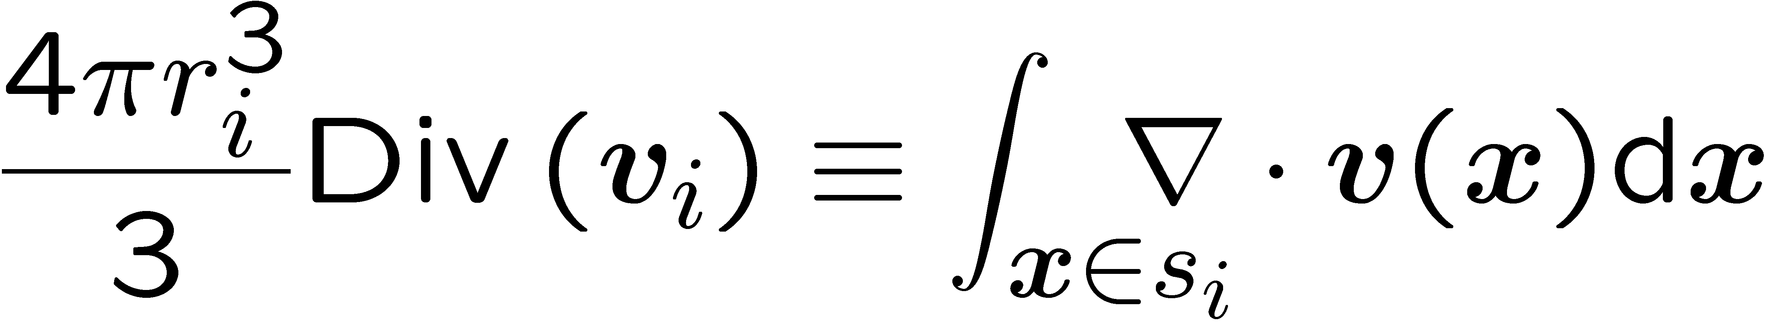
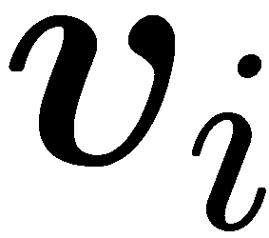
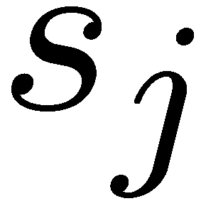
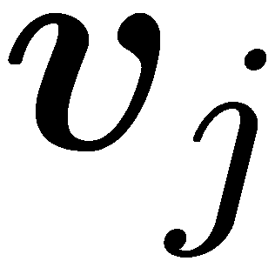
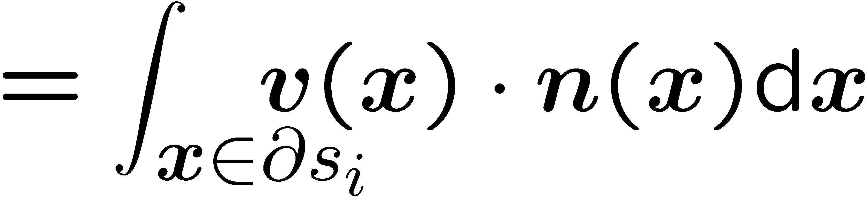
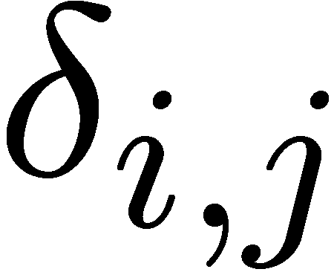
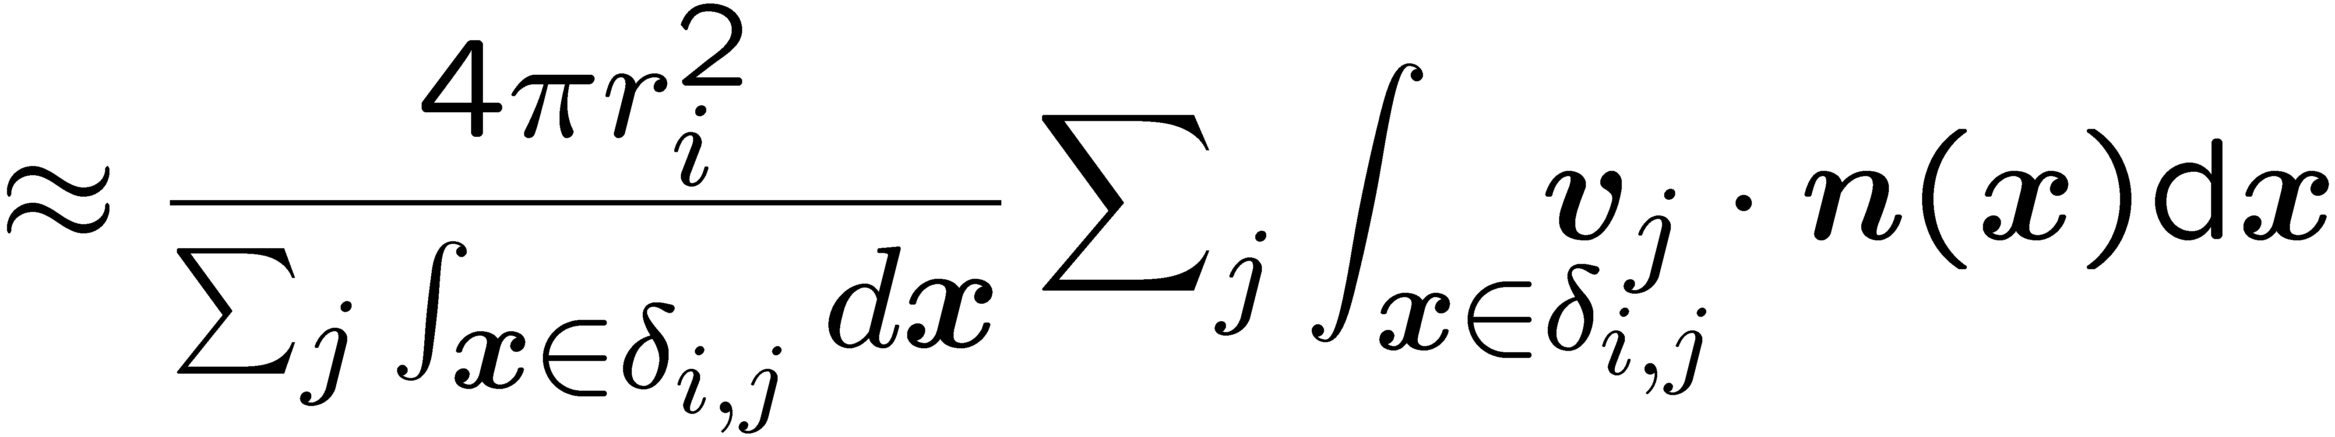
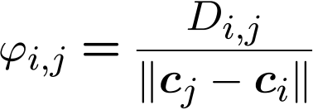
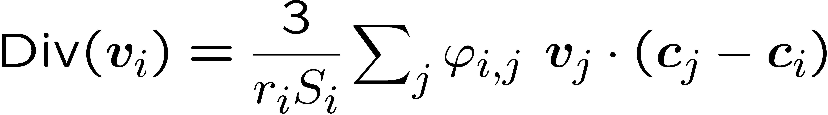
Differential Operators for PU
at center
Vector at point :
Assumption 1
support has a
constant vector
divergence theorem
Assumption 2
is covered only
by and
Notes:
Unfortunately, diff. operators for a spherical cover have not been proposed.
So we derive them.
All the following processes are performed only on the centers of supports,
Hence we define the operators only on the centers.
First we assume that each support has a constant vector.
and define the vector at x as an weighted average form.
We define the discrete Div operator as an average of the continuous div. of the vector field.
By the divergence theorem,
the right hand side can be rewritten in a surface integration form.
Next, we assume that the boundary of s_i inside s_j,
this right green curve denoted as delta_i,j,
is covered only by s_i and s_j,
Then this terms can be approximated like this.
And we obtain the Div. oparator.
S_i means this summention
and D_i in phi_ij is the area of the disk whose boundary is the intersection of s_i and s_j.
//By replacing this D_ij / |c_i – c_j | as phi,
//Div can be rewritten as this.

Slide 19


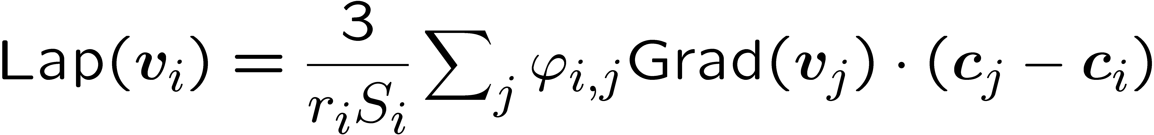
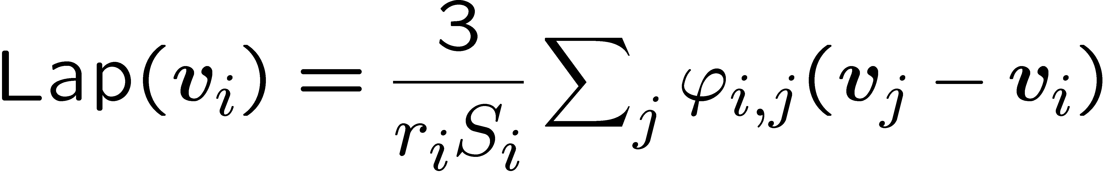
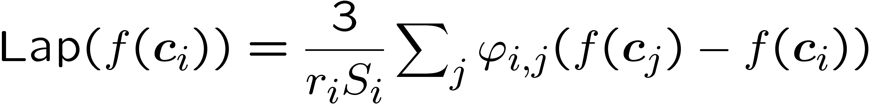
Differential Operators for PU
Replace with
Taylor expansion
Notes:
Next, we derive the Lap. operator based on the Div. operator.
As the traditional operators, we define the Lap operator as the Div of Grad(v).
Replacing v with Grad(v),
the equation about the Lap. operator can be obtained.
With the 1st-order Taylor expansion for this part,
the Lap. operator is derived.
In the same manner, the Lap operator for a function can be obtained.

Slide 20
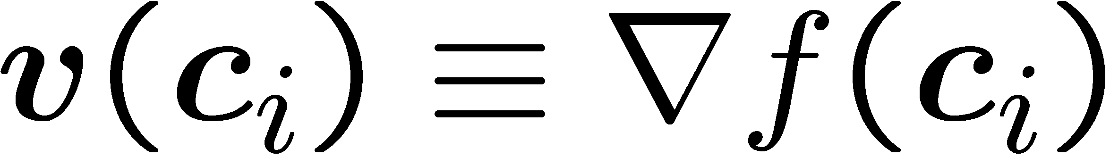
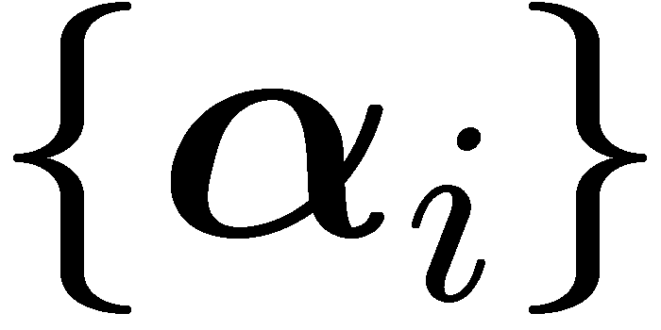
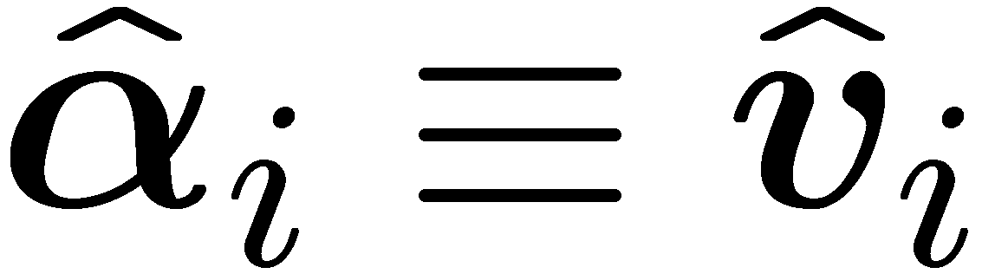




Algorithm: smoothing PU
Iterative smoothing
Local function:
PU generation
Initialize
the vector field
Smoothing
Update
Mesh
generation
Update
satisfies
Notes:
Now we have dif. Operators for a spherical cover.
Here I explain the smoothing procedure.
PU is not noise robust
so generated models are affected by noise.
We can say intuitively
that this smoothing “corrects” the approximated surface.
First, the vector field is initialized by the gradient of f(x).
Next, the coefficient vector alpha_i of local approximation g_i. is updated.
The updated vector is a vector smoothed by the Lap smoothind.
Finally the constant term beta_i of g_i is updated
Reflecting the smoothing.
We iterate this process.

Slide 21




Update of
Update to averaged gradient vector
Notes:
The update of alpha_i is done by Lap. smoothing.
The updated alpha_i is a weighted average of the gradient vectors
represented in this formula.
The left image shows a state before smoothing.
The gradient v_i is not matched with surrounding gradients.
By the Lap smoothing,
it is matched
and more smooth vector field is obtained.
//vector v_i has been set to grad(f(x)) in the previous step.

Slide 22



Update of
weak formulation
Assumption:
Notes:
The update of beta_i is realized by this equation.
It means that the gradient field is the smoothed vector field.
We solve the weak formulation.
The updated beta is represented in this formula
under the assumption that the value of f(x) at the center is beta_i.
Before updating,
the right green isoline is not matched with surrounding isosurfaces.
After updating, it is matched and more smooth scalar field is obtained.

Slide 23


Effect of Smoothing
…Edges are smoothed
Initial PU
Smoothed PU
Notes:
This is a result of this smoothing.
The initial PU is affected by noise.
By the smoothing the surface becomes smooth
but the edges are lost.
So we try to preserve edges.

Slide 24




Anisotropic Smoothing
Anisotropic factor
  Difference of gradients
Taking into updating of local functions
Notes:
We introduce anisotropic factor psi_ij.
It reflects the difference of gradients.
Near highly curved regions,
gradients are not continuous.
This asnisotropic factor gives small weights to region where the difference of gradients is large.
We take psi_ij into the updating of local functions.

Slide 25

Effect of Anisotropic Smoothing
Initial PU
Anisotropic smoothing
Notes:
These images show the effect of aniso smoothing.
The edges are better approximated.

Slide 26



Detail Preservation
Avoid oversmoothing
Fit the surface to the sampling points
PU
Oversmoothed
Detail preserved
Notes:
Moreover in order to avoid oversmoothing,
we fit the surface to the sampling points.
The center is the initial PU surface,
the left is the result without this fitting,
and the right is the result with fitting.
Details are better represented.

Slide 27


Detail Preservation
Smoothing terms + Fitting terms
  Update of
  Update of
Notes:
for DP, we introduce fitting terms into the update of alpha_i and beta_i.
For updating of alpha_i,
the gradient v_i, this blue arrow,
is fit to the weighted sum of normals of sampling points.
For updating of beta,
the zero-level is fit to the sampling points.
Lambda_n and lambda_p are large enough numbers.
All results in this presentation are obtained with fixed values.

Slide 28


Convergence
No notable differences
iterations
Initial PU
5
20
Notes:
In our experiments, 5 iterations are enough.
The result has no notable differences with the result by 20-times iteration.

Slide 29
Outline
Introduction
Algorithm
Results
Conclusion & Discussion
Notes:
In the last part of this presentation,
I will show some experimental results
and state conclusion and discussion.

Slide 30









Parameters
User’s parameter is only accuracy
  All the others are basically fixed
Notes:
All parameters except for the error tolerance ε are fixed.
These are results with different values of epsilon.
From left to right, the value decreases.
These are close-ups of the faces.
Buddha becomes more smiley.

Slide 31



Performance
Intel Core2Duo 3.0GHz with 8.0GB RAM
Model # points
 | Bunny 362K 2.5 | Buddha rough 3.2M 2.5 | Buddha precise 3.2M 1.25 | Armadillo 2.3M 1.0
# supports | 176K | 540K | 2.94M | 7.35M
Time [min:sec] | 0:51 | 3:29 | 17:84 | 45:52
Peak RAM | 74M | 234M | 1.23G | 3.24G
Cost # supports
Notes:
This table shows the performance.
The Stanford bunny with about 400K points needs 50 sec.
Buddha over 3M points takes 3.5 min.
More details are shown in our paper.
Computational cost is almost proportional to the # of supports.
***********************************
ウサギ○分○秒
数百点で○分○秒
More details are in our paper.

Slide 32







Robustness
Noise
Normal noise
Noise x 2
Rotated
by 30°
Rotated
by 60°
Normal fitting
No normal fitting
Notes:
These results shows noise robustness.
This is the result for a noisy data
and the right is a result for more noisy data.
Even such this data, the result is topologically correct.
The lower images show the robustness for normal noise.
This is a result for a data with normals randomly rotated by 30◦.
Our algorithm succeeds.
But for a rotation angle of 60◦,
the reconstructed model is affected by normal noise.
Without normal fitting term,
a smooth surface is obtained.

Slide 33







Comparison
Input
Poisson surface
reconstruction
[Kazhdan et al. 06]
MPU
[Ohtake et al. 03]
Our approach
Notes:
This is a comparison for the sii-sa model with MPU by Ohtake and Poisson by Kazhdan.
MPU generates some extra components.
In the result by Poisson, some details are lost by oversmoothing.
On the other hand our results can generate better approximation.

Slide 34






Comparison
Poisson surface
reconstruction
Our method
Notes:
This is another comparison with Poisson.
Both methods work well.
We can see small scale pattern is more clear in our result.

Slide 35








Comparison
Sparse
Poisson surface reconstruction
Our method
Notes:
Here we show the differences of the properties of the reconstructed surfaces.
Inputs are gradually sparsely sampled points.
Surface generated by Poisson tends to shrink in sparse areas.
Our algorithm does not cause such a shrinking problem.

Slide 36




Surfaces’ Properties
Extending in the tangential directions
(Octant)
Poisson surface reconstruction
Our method
Input points
Notes:
This example shows the difference of properties more clearly.
The input is points partly sampled from an octant.
Poisson generates a rounded shape.
Our method generates a model extending in the tangential directions.

Slide 37

Conclusion
New differential operators for a spherical cover
Detail-preserving and noise robust surface reconstruction algorithm
Diffusion technique
Notes:
Conc.
We derived new differential operators for a spherical cover.
By a Diffusion technique using the operators,
detail-preserving and noise robust surface reconstruction algorithm has been proposed.

Slide 38
Future Work
Operators’ Limitations
  Div: PU with constant vector field
  Lap: linear local function
Changing primitives: linear → quadratic /cubic
Representing sharp features
Volume processing
Notes:
The limitation of these operators are that
Div operator assumes that PU has a constant vector field
and
Lap operator assumes that local functions are linear.
Changing local functions from linear to quadratic /cubic is a future work.
We proposed anisotropic and detail preserving surface reconstruction,
but edges and corners have not been represented well.
Representing sharp features is another issue.
Finally we also plan to apply the differential operators to volume processing
and higher dimensional data.
***************
But in surface reconstruction,
Linear local functions are more noise robust than higher –order approximations.
Moreover, mesh is a piecewise linear representation.
So the 2nd assumption is reasonable.

